Slide 1
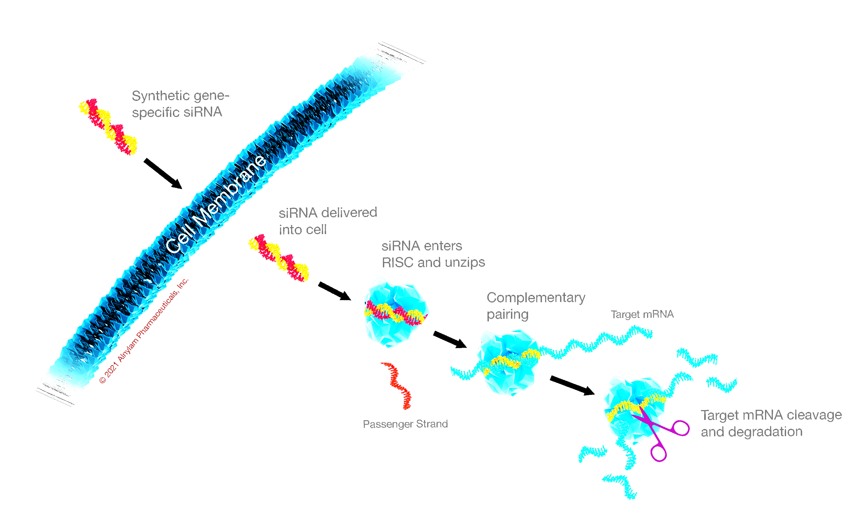
Building Alnylam, a Whole New Class of Medicines, and the Importance of Being Unreasonable; and, What’s Next
OTS: The Oligo Meeting
October 8, 2024
J M M
Innovations, LLC

Slide 2
Disclosure
John Maraganore is founding CEO of Alnylam Pharmaceutics
He retired from Alnylam at end-2021 after building company for ~20 years
Remains a significant shareholder
CEO and Principal of JMM Innovations, LLC
Committed to working with innovators, entrepreneurs, investors, and patient groups to advance novel medicines to patients and to develop the next generation of leaders
Involved in a number of additional activities
Advisor to investment groups, including: ARCH Ventures; Atlas Ventures; Blackstone Life Sciences; and RTW Investments
Board Director for public biopharmaceutical companies: Beam Therapeutics; Kymera Therapeutics; Rapport Therapeutics; Takeda Pharmaceuticals
Board Director for private biopharmaceutical companies, including: Aera Therapeutics; Aitia; City Therapeutics (co-founder); HeMab Therapeutics; Orbital Therapeutics (co-founder)
Strategic advisor for public and private biopharmaceutical companies
Director/Advisor for non-profit organizations and patient advocacy groups, including: Ariadne Labs; BIO; CHDI; Cure Duchenne, MGH Research Advisory Council; N-Lorem; Nucleate; Termeer Foundation
J M M
Innovations, LLC

Slide 3
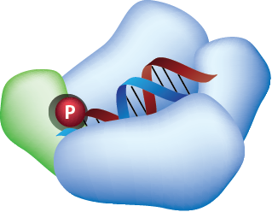

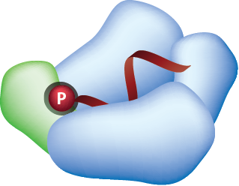
RNA Interference (RNAi) Pathway
Naturally Occurring Mechanism to Regulate Gene Expression
siRNA
Ability to harness an endogenous pathway
A
C
A
G
A
U
U
U
A
G
C
A
U
C
U
C
A
U
U
=
≡
≡
=
=
=
=
=
≡
≡
=
=
≡
=
≡
=
=
=
1. RISC
Loading
P
U
G
U
C
U
A
A
A
U
C
G
U
A
G
A
G
U
A
A
T
T
Catalytic mechanism
4. Target Cleavage
5. Catalytic Mechanism
RISC
Ability to silence ANY gene in genome
RNA-induced Silencing Complex (RISC)
mRNA
A
C
A
G
A
U
U
U
A
G
C
A
U
C
U
C
A
U
U
≡
=
=
≡
=
=
=
=
=
≡
≡
=
=
≡
=
≡
=
=
P
U
G
U
C
U
A
A
A
U
C
G
U
A
G
A
G
U
A
A
T
Ability to act upstream of today’s medicines
2. Sense Strand Removal
Antisense strand
T
Watson-Crick base pairs
Potential for whole new class of medicines: RNAi therapeutics
3. Target Recognition
J M M
Innovations, LLC

Slide 4
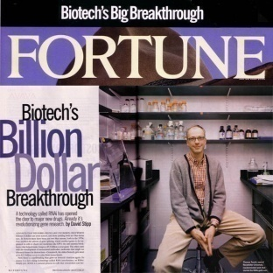
Alnylam Business Plan: 2003
Business Plan;
H1, 2003
Pipeline
NPV
Products
5+ years
Clinical
Efficacy
Value
Pharma
Deals
Clinical
Pipeline
3-5 years
10-20 Years
$1-2B
Pharma
Deals
Patent
Building
“Bloom on
The Rose”
2-3 years
J M M
Innovations, LLC
4

Slide 5
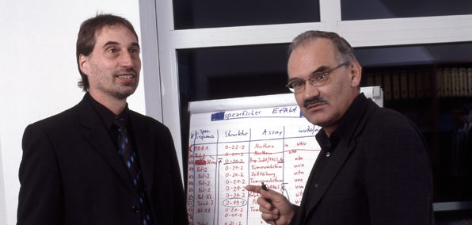
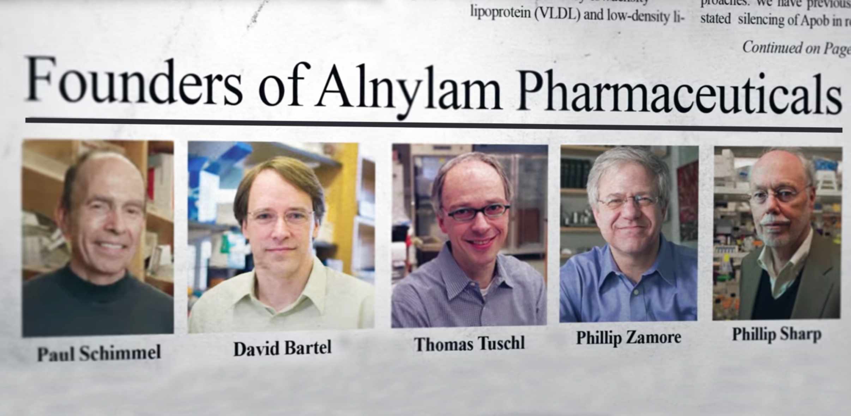



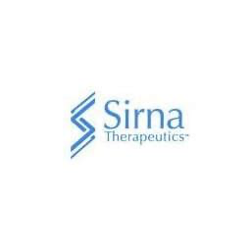

IP Consolidation
+
“Tuschl 1”
“Tuschl 2”
J M M
Innovations, LLC

Slide 6
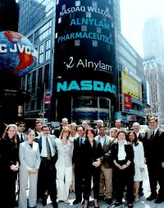
2004: ALNY IPO
Raised $30M at $98M pre-money valuation
~50% discount to offer price
Price of $6/share
IPO investors enjoyed 4666% increase in value
J M M
Innovations, LLC

Slide 7
Alnylam Business Plan: 2003
Business Plan;
H1, 2003
Pipeline
NPV
Products
5+ years
Clinical
Efficacy
Value
Pharma
Deals
Clinical
Pipeline
3-5 years
10-20 Years
$1-2B
Pharma
Deals
Patent
Building
“Bloom on
The Rose”
2-3 years
J M M
Innovations, LLC
7

Slide 8
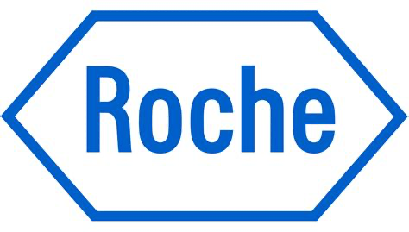
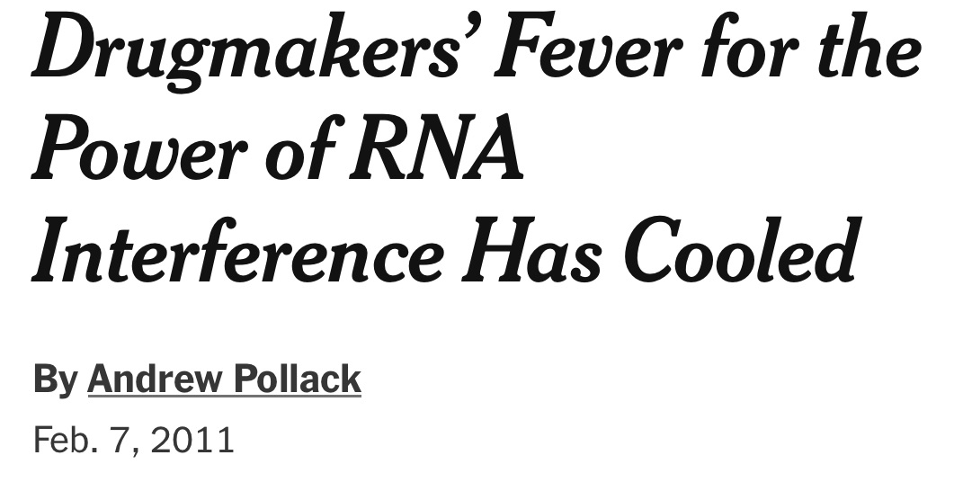
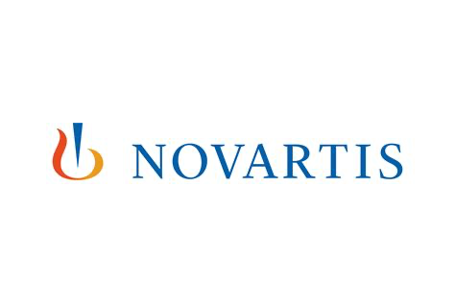

Alnylam Early Partnerships
2003: $7.5M upfront
2007: $331M upfront
2005: $57M upfront, 19.9% equity
2008: $150M upfront
J M M
Innovations, LLC

Slide 9
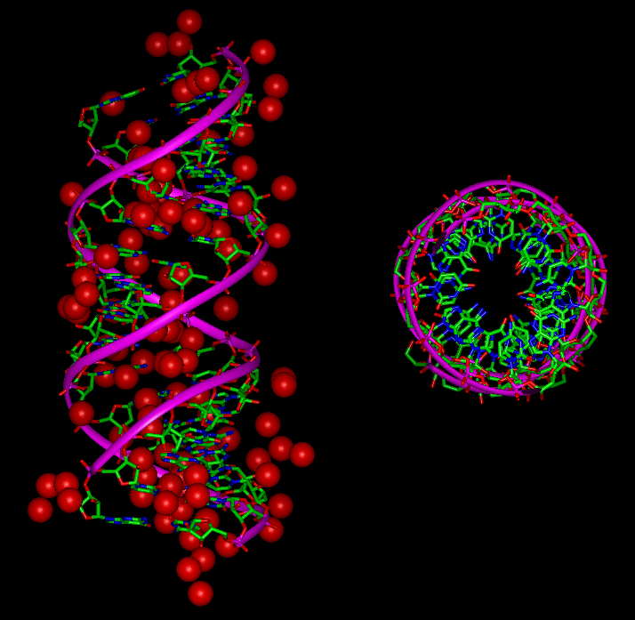
Making Drugs Out of siRNA
The Challenge
Characteristics
M.W 12,000-14,000
Size: 2 turns of helix
40 negative charges
Hydrophilic
Hydrated heavily
ca. 5.5 nm X 2 nm
Biostability
Sense strand
2 bp (double) 3’ overhangs
21-23 base pairs long
dsRNA
Seed sequence
(residues 2-8)
Anti-sense or
‘Guide’ strand
J M M
Innovations, LLC

Slide 10

Addressing Delivery Challenge
Sense strand
Antisense strand
Lipid Nanoparticles (LNPs)
Multi-component lipid formulation (~100 nm in size)
Encapsulated siRNA
Highly efficient for targeted delivery to liver
Administered intravenously (IV)
Clinically validated
Patisiran
J M M
Innovations, LLC

Slide 11
Novel Lipid Discovery to Improve LNP Therapeutic Index
J M M
Innovations, LLC

Slide 12

Addressing Delivery Challenge
Sense strand
Antisense strand
Lipid Nanoparticles (LNPs)
Multi-component lipid formulation (~100 nm in size)
Encapsulated siRNA
Highly efficient for targeted delivery to liver
Administered intravenously (IV)
Clinically validated
=
GalNAc
GalNAc-siRNA Conjugates
Single chemical entity
GalNAc ligand conjugated to extensively modified siRNA
Targeted delivery to liver
Administered subcutaneously (SC)
Clinically validated
Patisiran
J M M
Innovations, LLC

Slide 13
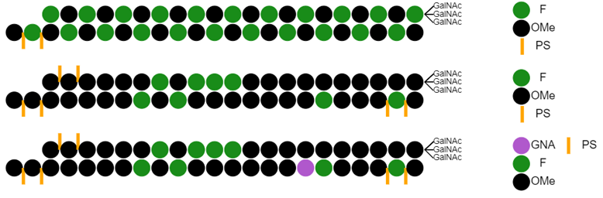
Evolution of GalNAc Conjugates
STC
5’
5’
ESC
5’
5’
5’
ESC+
5’
J M M
Innovations, LLC

Slide 14
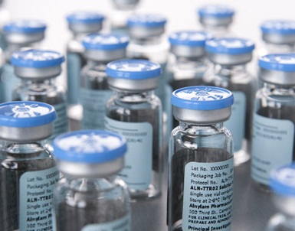
2011: Transition from Platform to Product
RNAi for genetically defined disease as core strategy
5 Key products in clinical development through 2015
Near term focus on ATTR, hemophilia, and porphyria programs
Product characteristics
Genetically defined target/disease
Existing Alnylam delivery platform
Phase I proof of concept
Clear and rapid development
Significant commercial opportunity
J M M
Innovations, LLC

Slide 15
First Evidence RNAi Works in Humans
J M M
Innovations, LLC

Slide 16
Alnylam Pipeline Mid-2014
J M M
Innovations, LLC

Slide 17
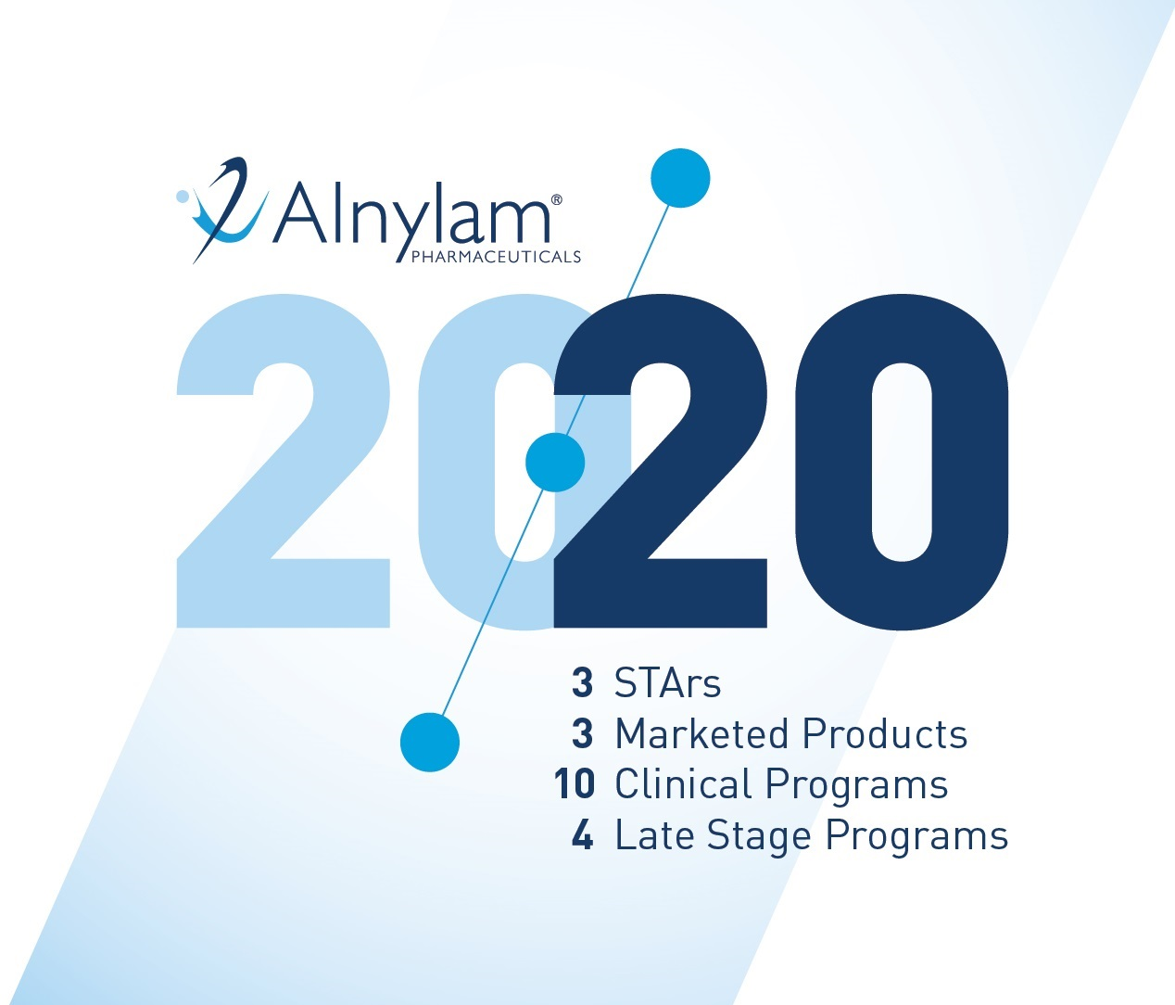
2015: Transition from Pipeline to Products
J M M
Innovations, LLC

Slide 18
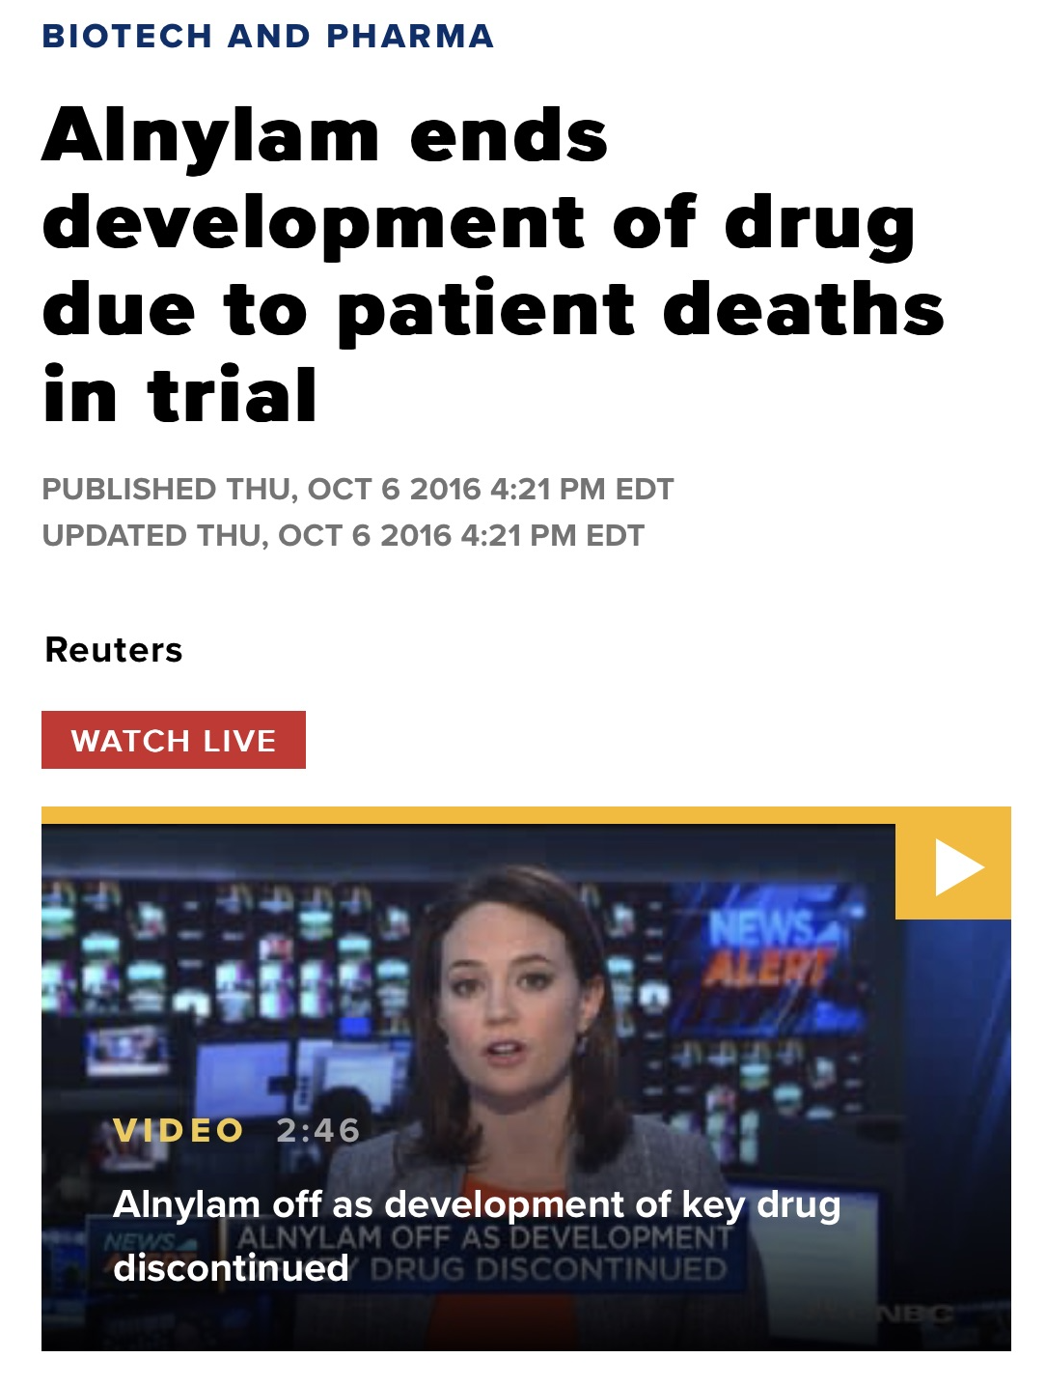
Revusiran Phase 3 ENDEAVOUR Trial
J M M
Innovations, LLC

Slide 19
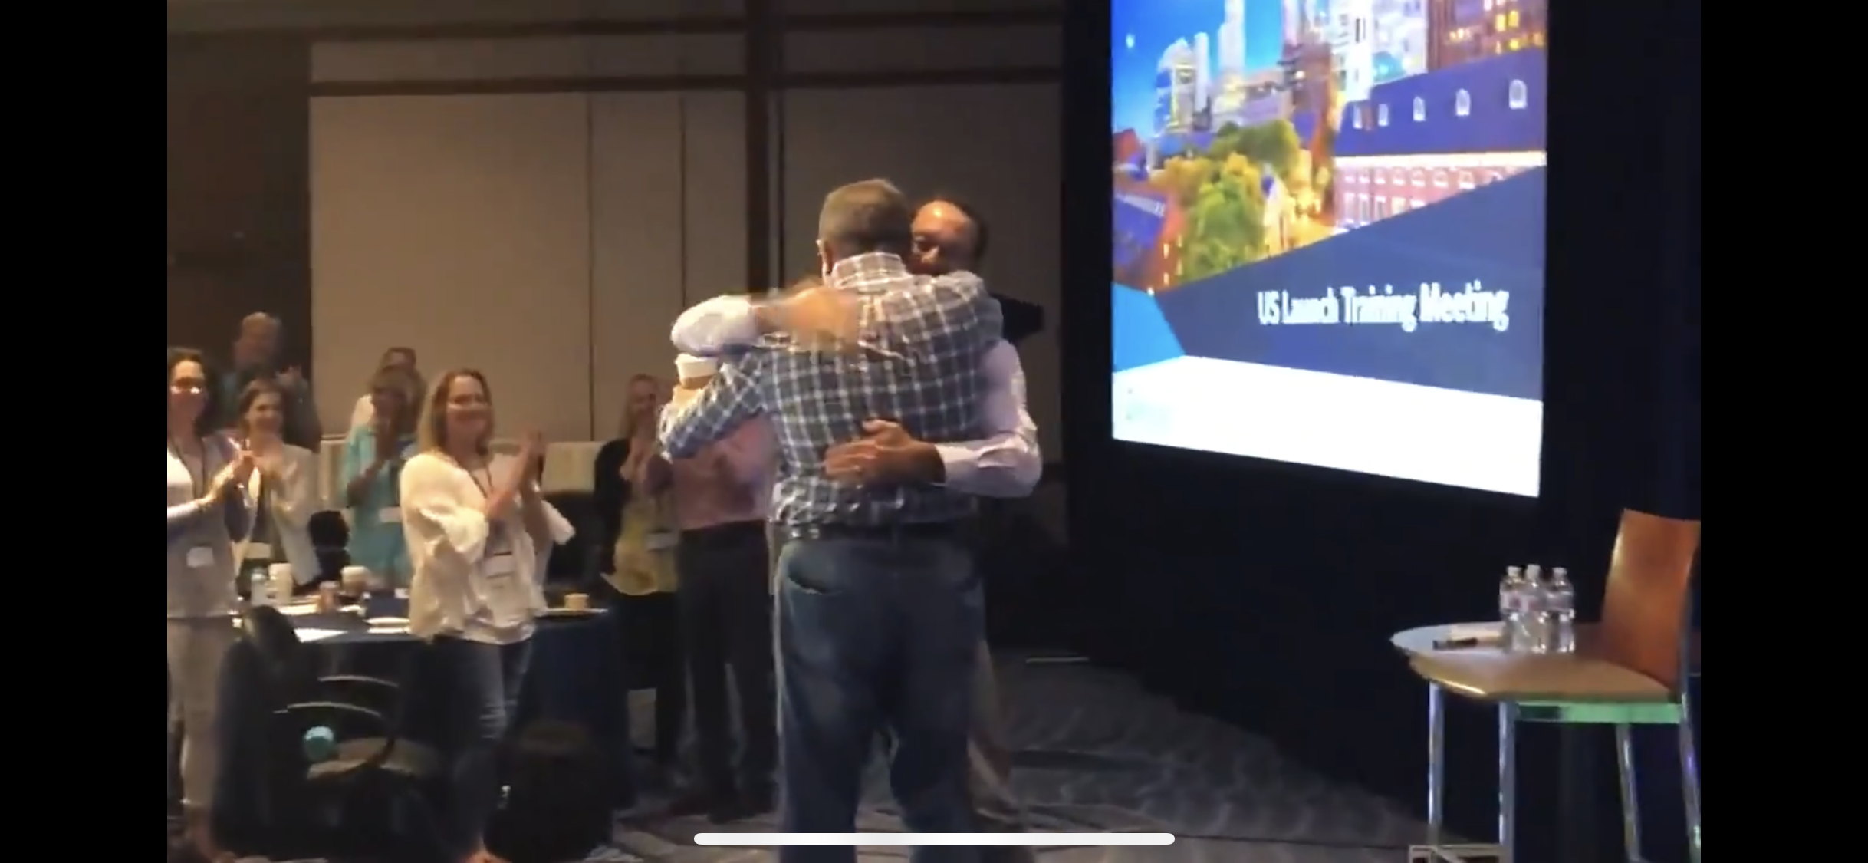
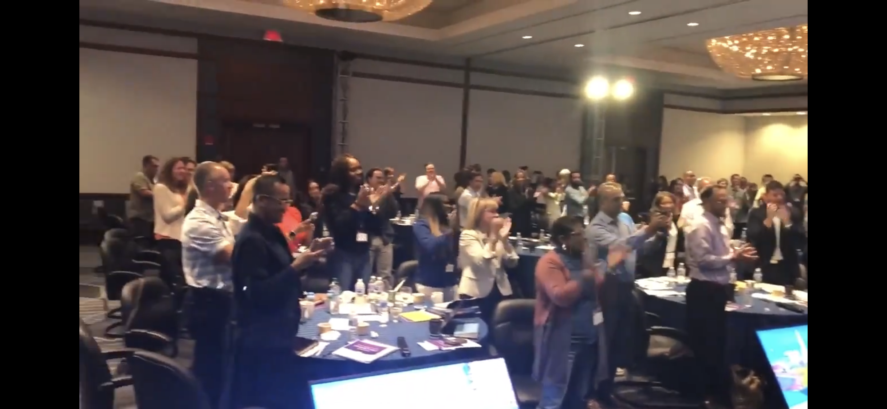
First RNAi Therapeutic Reaches Market
APOLLO Phase 3 Study Results
J M M
Innovations, LLC
Adams et al., N Engl J Med. 379:11-21 (2018)

Slide 20

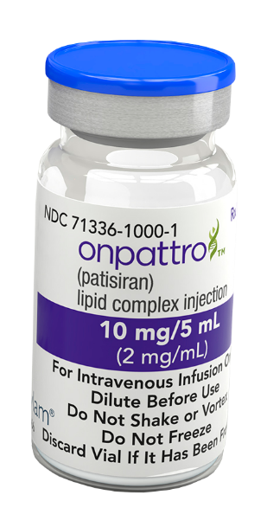
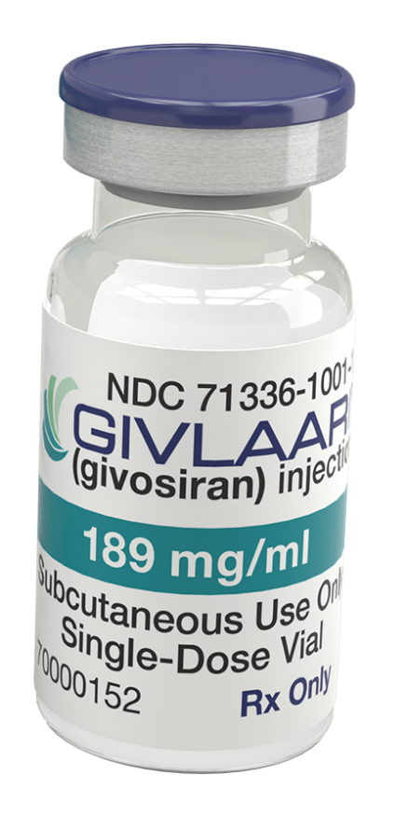
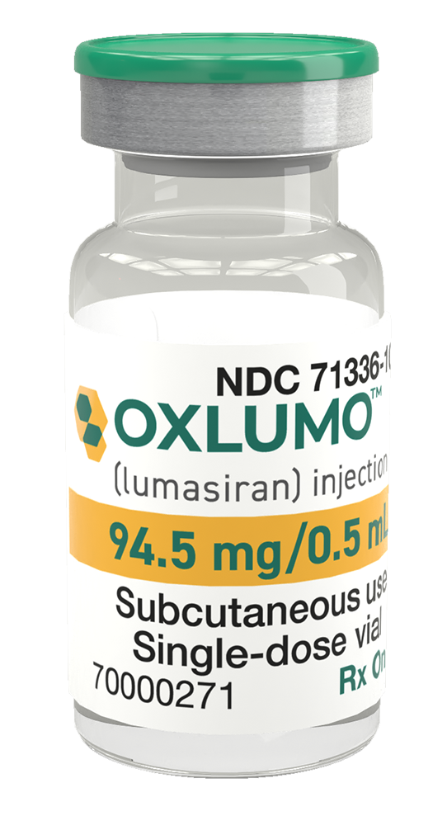
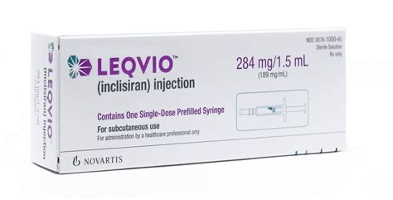
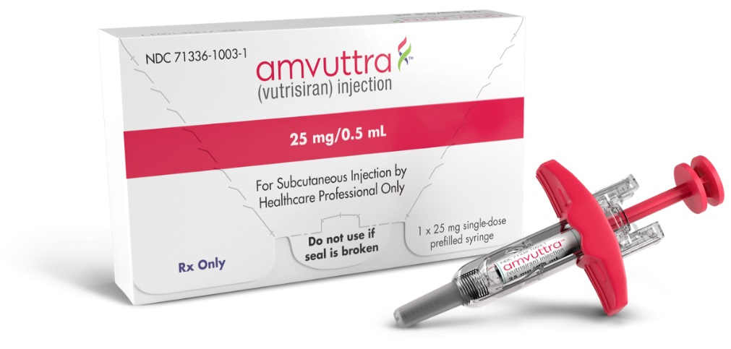
A Whole New Class of Medicines
Five RNAi Therapeutic Medicines Approved from 2018-2022
2018
2019
2020
2021
2022
J M M
Innovations, LLC

Slide 21
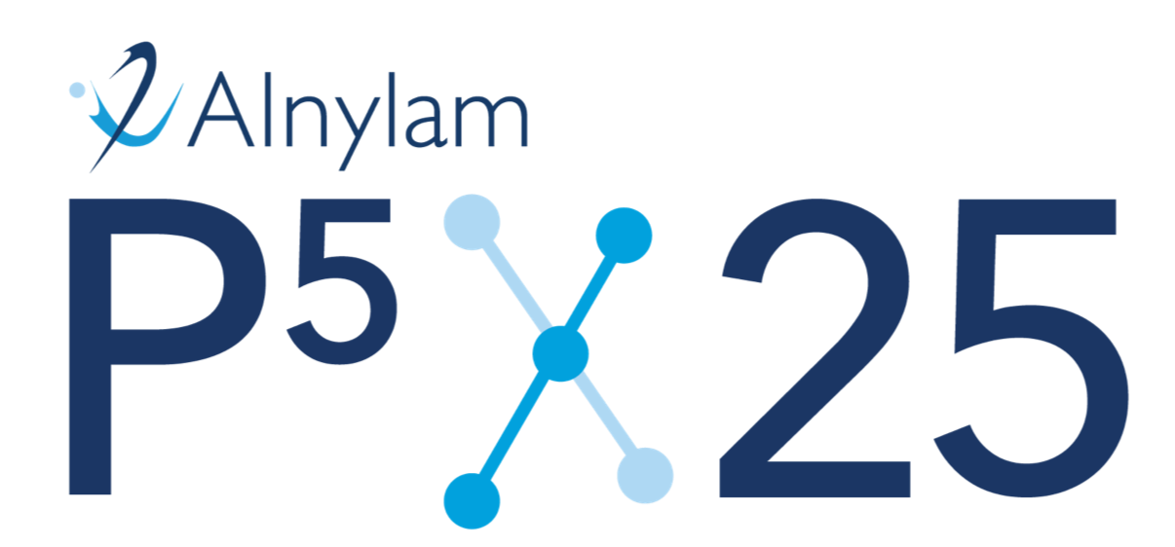
2021: Transition from Products to Top 5 Biopharma
RANK | COMPANY | MARKET CAP (Billions)
1 | Amgen | $181
2 | Regeneron | $126
3 | Vertex | $120
4 | Gilead | $105
5 | Alnylam | $35
…
Patients: >0.5M on Alnylam RNAi therapeutics
Products: 6 or more marketed products
Pipeline: >20 clinical programs + 4 INDs/yr
Performance: >40% Revenue CAGR thru YE 2025
Profitability: Achieve non-GAAP profitability
J M M
Innovations, LLC

Slide 22
Next Generation RNAi
September 2024

Slide 23



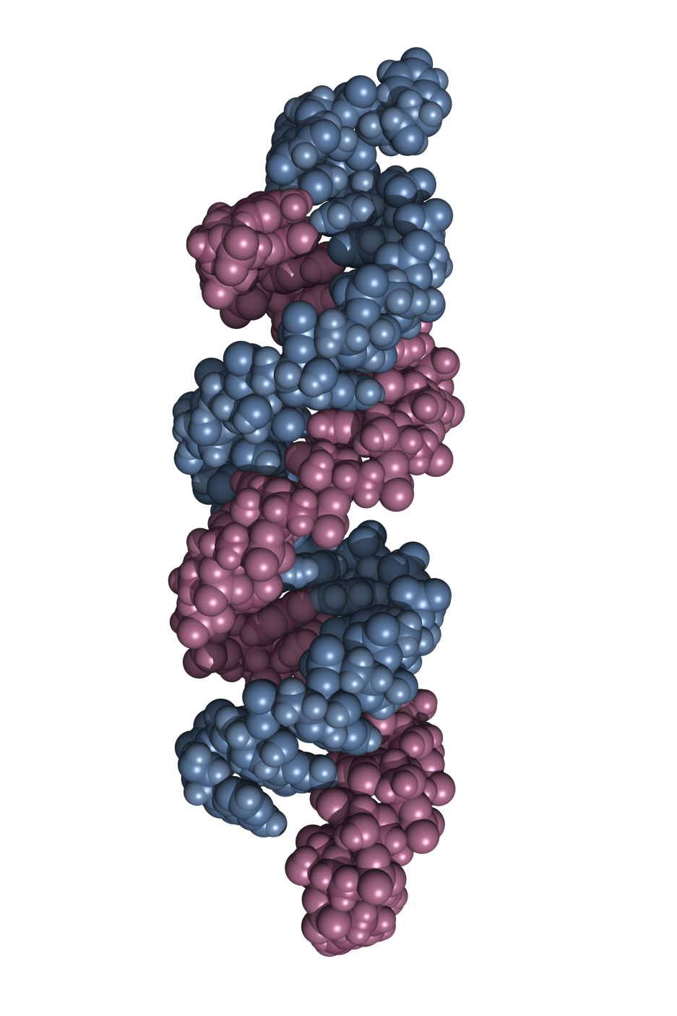



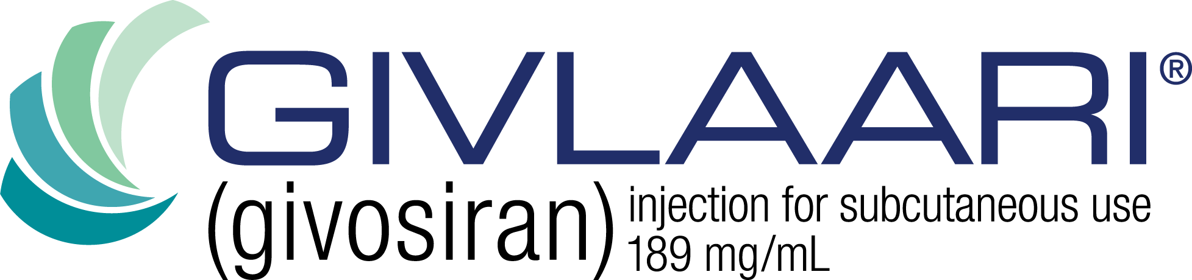
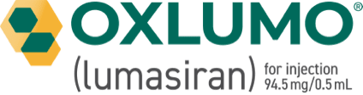

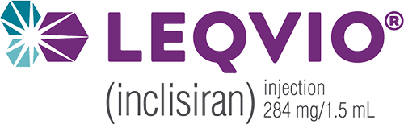
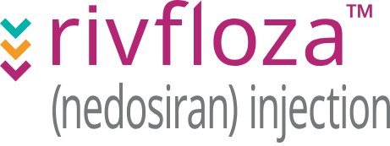
RNAi is transforming medicine and has come of age
Six FDA approvals since 2018, driven by unique strengths compared to existing modalities
Potent Efficacy
6 approved RNAi medicines with transformational patient benefit
True Product Platform
Rational design for specific genes, <12 months to development candidate and high PTRS
Long durability Twice yearly dosing potential, sustained pharmacology, improved adherence
Excellent Specificity & Safety RNAi medicines with high specificity and outstanding safety profile

Slide 24
Time to enter RNAi revolution is now
RNAi today is where antibodies were in the late 1990s
Antibodies
RNAi
6 approved RNAi drugs in first 5 years – similar to antibodies
~$60B value created (market cap and M&A)
~ 20 years to develop antibody technology
~20 years to develop RNAi technology

Slide 25









We are at the dawn of extrahepatic RNAi
Liver
Lungs
Neurons
Muscle
Eye
Pancreas
Immune cells
Cardiac muscle
Kidneys
Each extrahepatic tissue uncovers tremendous value (e.g. GalNAc: 6 drugs and numerous candidates)
200+ cell types yet to be targeted
1000’s of diseases yet to be treated

Slide 26
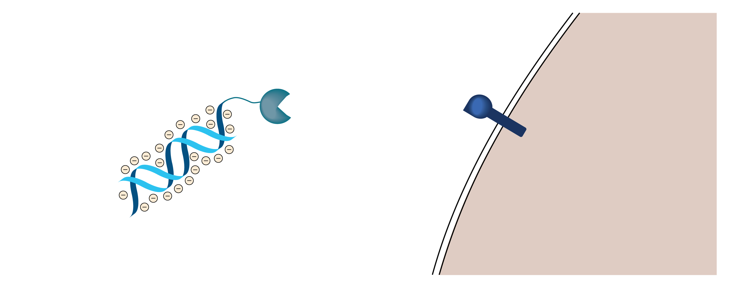
Room for improvement with 1st Generation RNAi
Next generation RNAi needed to expand beyond liver
Canonical siRNA: ~21nt > 40 negative charges
Limited distribution & cellular uptake
Receptor for endocytosis and RNAi uptake
Few targeting ligands GalNAc, C16, integrin, TfR
Delivery limited to few organs

Slide 27

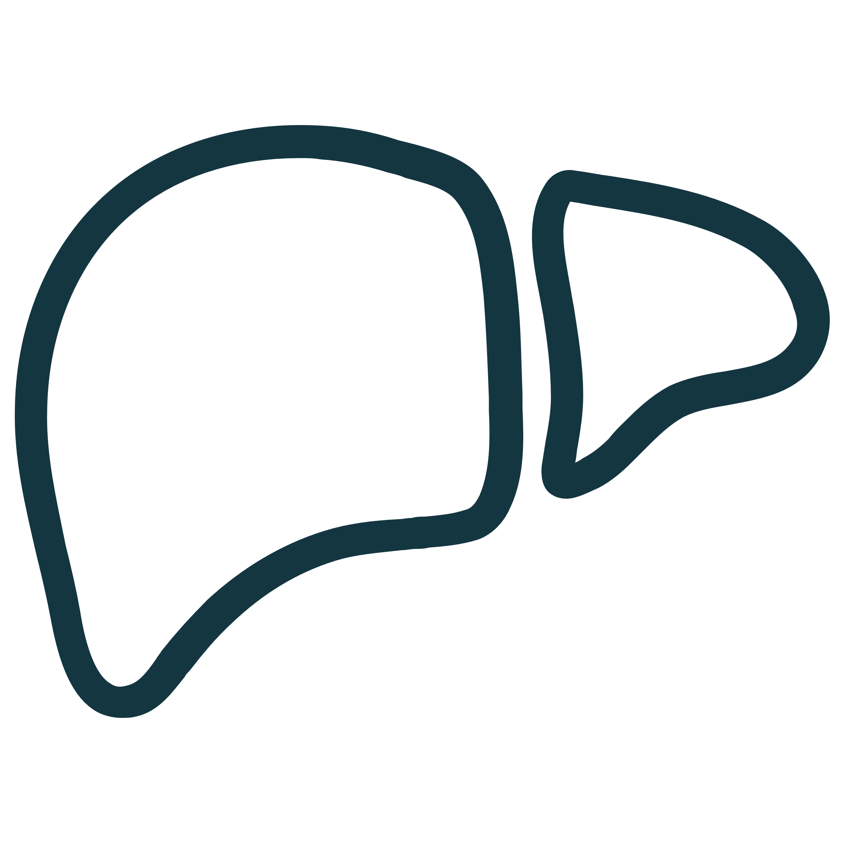

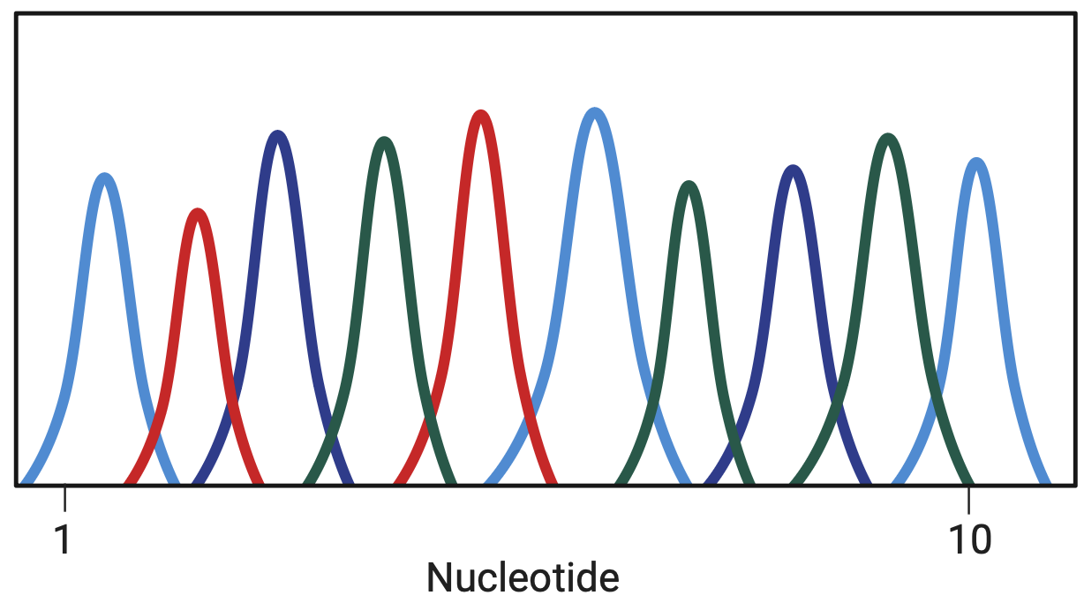

City Therapeutics Platform
Novel trigger mechanisms
Targeting ligands
Human molecular genetics
-33%
1/3 smaller, less charge
Strong foundational IP
Proprietary targeting ligands for extrahepatic delivery
Identification of targets with high conviction

Slide 28

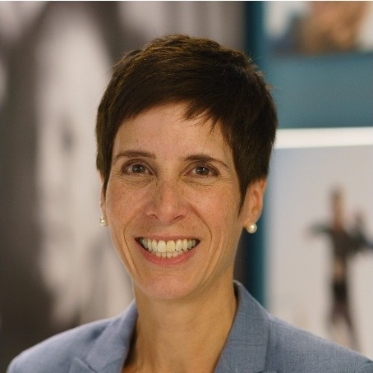
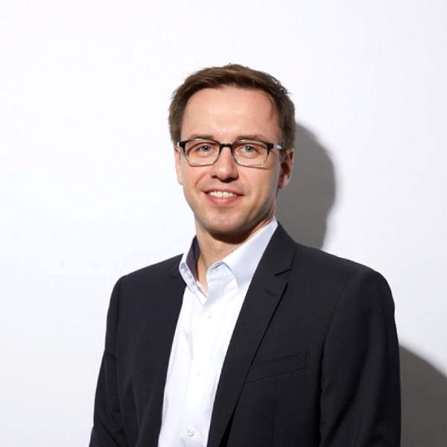






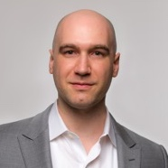







Our founders are the leaders in RNAi
=
Founding leadership team
John Maraganore, PhD
Tracy Zimmermann, PhD
Sebastian Trousil, PhD
Founding board member
Robert Nelsen
Executive Chairman
CSO
COO
ARCH Co-Founder & Managing Director
Former and Founding CEO
Onpattro, Gilvaari, Oxlumo, Leqvio, Amvuttra
Millennium Pharmaceuticals Inc.
Biogen
Program Lead for Amvuttra
RNAi drug discovery
RNAi platform development
Harbinger Health
Harvard Medical School
Juno Therapeutics, Grail, Denali, Karuna Therapeutics, Sage Therapeutics, Agios, Vir
Ari Nowacek, MD, PhD
Kotaro Nakanishi, PhD
Yukihide Tomari, PhD
Phillip D. Zamore, PhD
Non-executive founders
Biotech company building
Investing and operations
Discovery of cityRNA
Mechanisms of RNAi and non-coding RNA
RNA biology
Mechanisms of RNAi and non-coding RNA
RNAi Pioneer
Chair, RNA Therapeutics Institute, UMass Chan Medical School
ROME Therapeutics, Synchron, Walden Biosciences, Arbor Biotech, Hiber Cell
Howard Hughes Medical Institute, RNA Therapeutics Institute

Slide 29
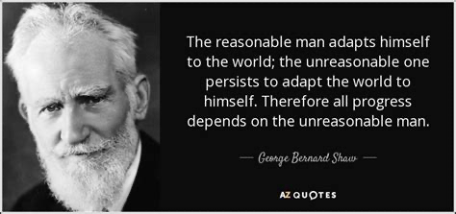
J M M
Innovations, LLC

Slide 30
Randomized, Active-Controlled Study of Culture in Biotech
Co-Primary Endpoints: Net Value Creation & Number of INDs Filed
BASELINE CHARACTERISTICS
2006
2014
••••••••••••••••••••••••••••••••••••••••
COMPANY | ALNYLAM | SIRNA
FTEs | 75-100 | 75-100
IP | Similar | Similar
Market Cap | ~$550M | ~$450M
Partnerships | Merck Novartis | Allergan GSK Lilly
••••••••••
Acquired by Merck for $1.1B
Invests ~$1.6B
200-300 FTEs
Acquired by Alnylam for $175M
••••••••••
Remains independent
Invests ~$500M
~200 FTEs
Market cap ~$5B
2006
2014
••••••••••••••••••••••••••••••••••••••••
0
8
~($0.3)B
~$4.0B
# INDs Filed
# INDs Filed
Net Value Creation
Net Value Creation
RSV (in. & aer.)
VSP
TTR (01 & 02)
PCS02
Revusiran
Inclisiran
J M M
Innovations, LLC

Slide 31
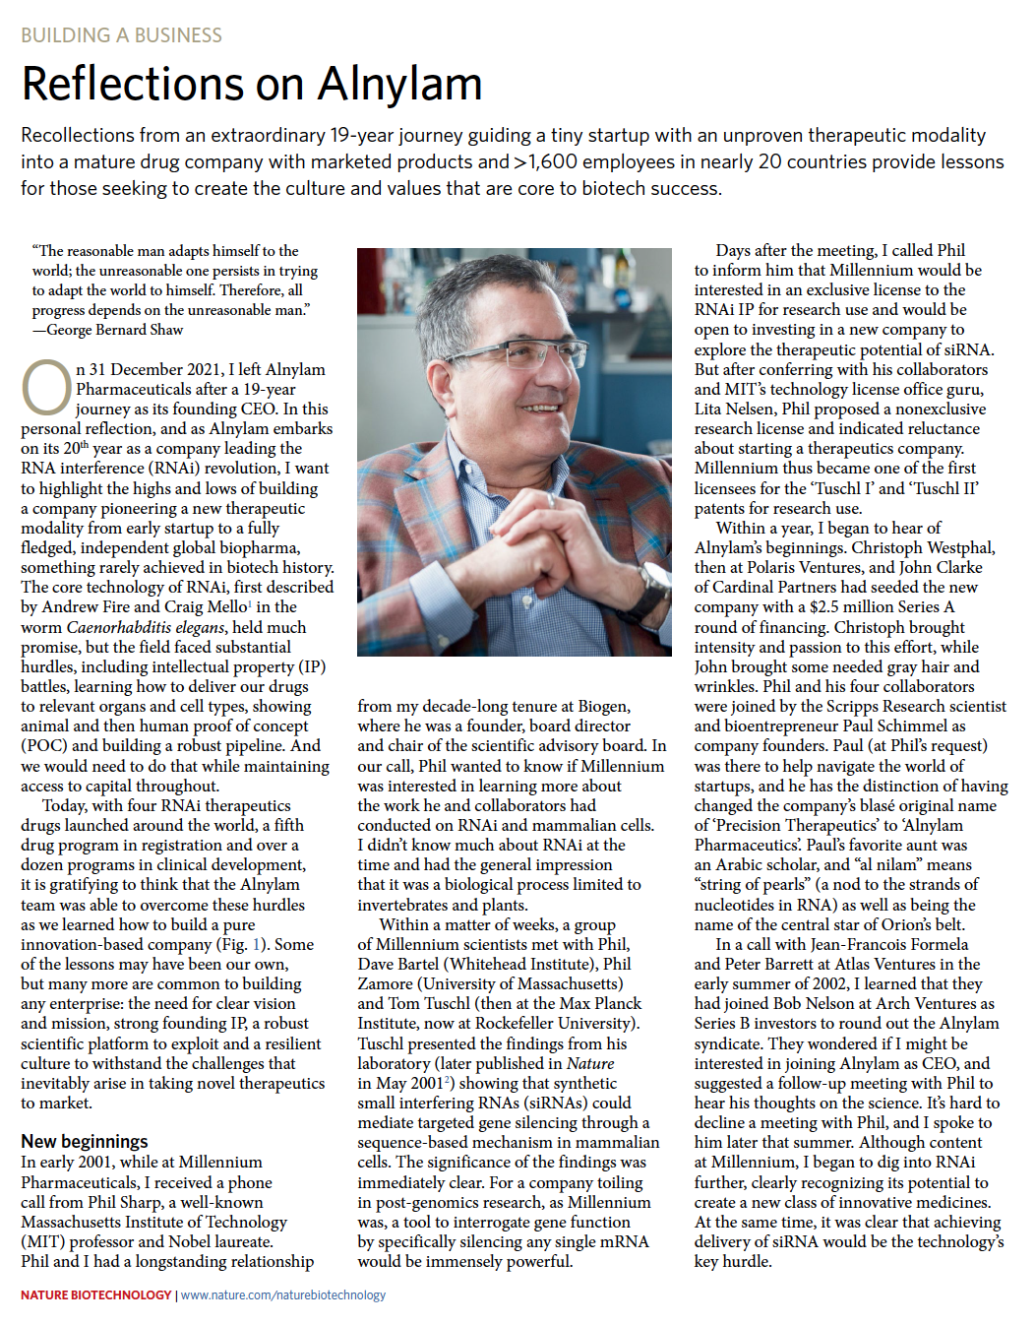
Further Reading
Nature Biotechnology (2022) 40, 641-650
J M M
Innovations, LLC

